Slide 1
Intelligent Cylinder Head Bolt Measurement System
Capstone Project 3
Team Members
Antony Akwalu
Gaurawa Kovida
Nipun Gunarathne
Mate Ganbat
Sass Bendeguz
Szabo Vilmos Benedek

Slide 2
Team Structure & Workflow
Role | Member
Hardware | Nipun
 | Antony
Software | Mate
 | Kovida
Measurement | Benedek
 | Bendeguz
Organization: Division into three specialized sub-teams:
Hardware: Soldering, circuit construction, sensor integration.
Software: Code structure, DAQ system, UI generation.
Measurement: Calibration, execution, data analysis

Slide 3

Project Goals
Analyze stress and load states of bolts and cylinder heads.
Build and calibrate a functional transducer system.
Compare tightening processes using professional data acquisition.
Demonstrate professional project management through sub-team division.

Slide 4
System Overview
Core Components: Force transducer, HX711 Signal Amplifier, ESP32 Micro-controller
The force transducer utilizes a hardened steel ring as an elastic element that deforms under the bolt's clamping load, which is detected by dual-grid strain gauges bonded to its surface.
This mechanical deformation is converted into a digital signal through a Full Wheatstone Bridge circuit and a 24-bit HX711 amplifier, allowing the ESP32 microcontroller to precisely quantify the high compressive forces

Slide 5
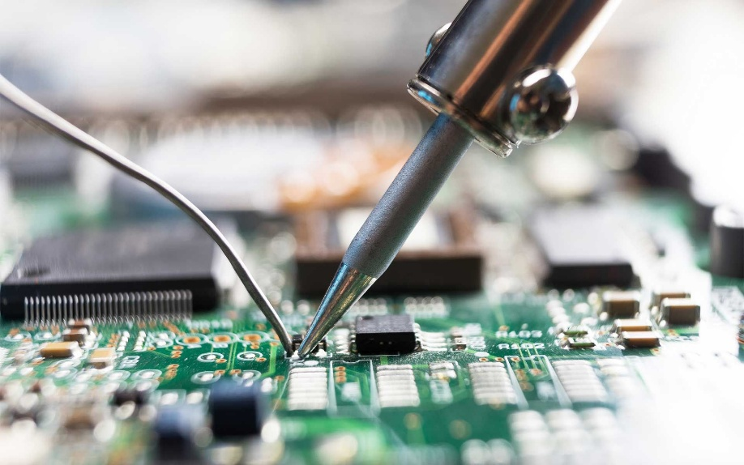
Steps of the Build
Soldering and its Basics
Soldering is a fundamental process used to join electrical components by melting a filler metal (tin) into the joint
Basics
Heat both parts sufficiently
Achieve shiny and cone-shaped joints

Slide 6
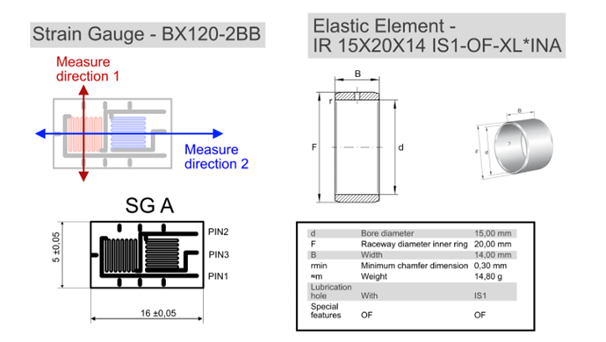
Strain gauges
We utilised the BX120-2BB Strain Gauge , a dual-grid sensor designed to measure deformation in two perpendicular directions.
The Elastic Element - a hardened steel ring (Model: IR 15x20x14 IS1-OF-XL). This component serves as the transducer body
The Sensor (BX120-2BB):The gauge features two distinct measuring grids:
Direction 1 (Red Arrow): Aligned to measure the primary axial strain (compression of the ring).
Direction 2 (Blue Arrow): Aligned to measure the transverse strain

Slide 7
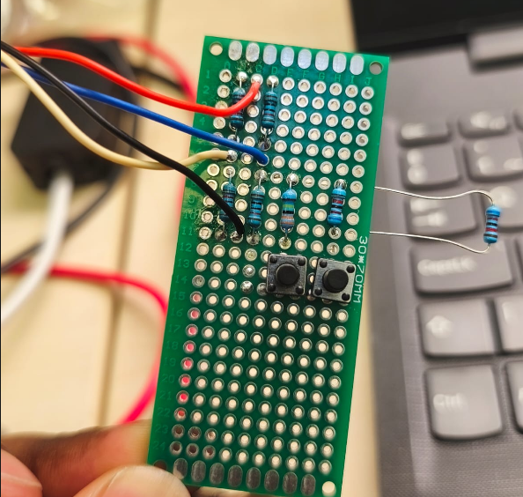
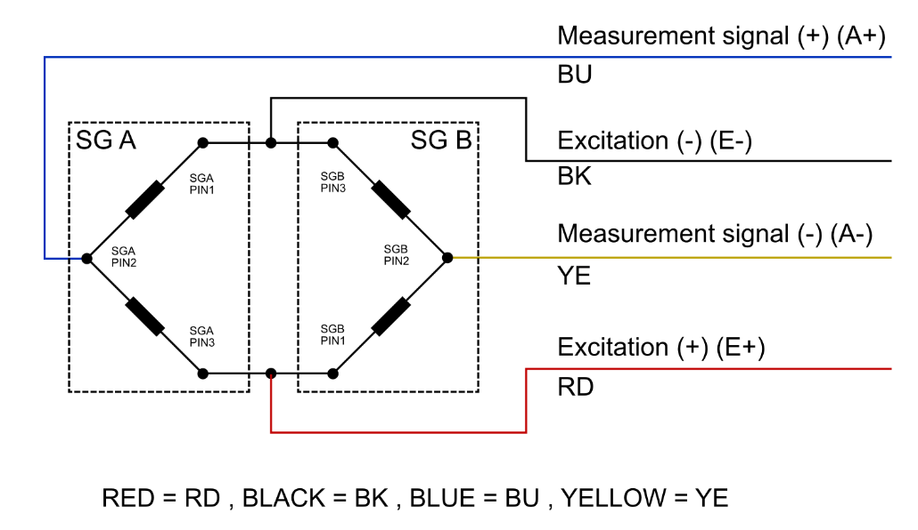
3. The Wheatstone Bridge
A Wheatstone bridge is an electrical circuit used to measure an unknown resistance by balancing two legs of a bridge circuit, one of which includes the unknown component
Prototype Wiring of the Wheatstone

Slide 8
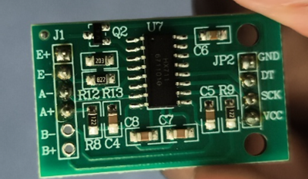
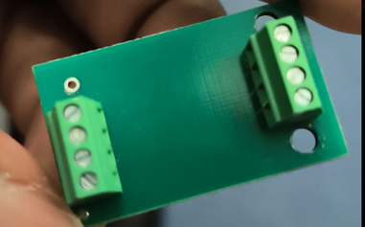
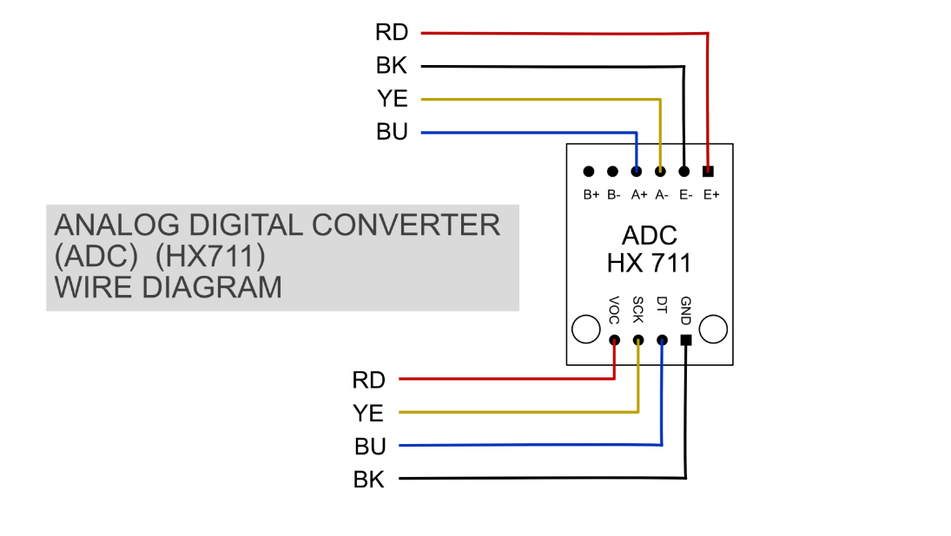
4. Signal Conditioning (HX711 Integration)
The signal output from the Wheatstone bridge is an analog voltage in the millivolt range, which is too weak and noisy for the microcontroller to read directly.
To solve this, we integrated the HX711 module, a 24-bit Analog-to-Digital Converter (ADC) designed for high-precision weigh scales.
Functions
Amplification of signal from bridge
Digitization of the analog voltage into a digital data stream that the ESP32 can process

Slide 9
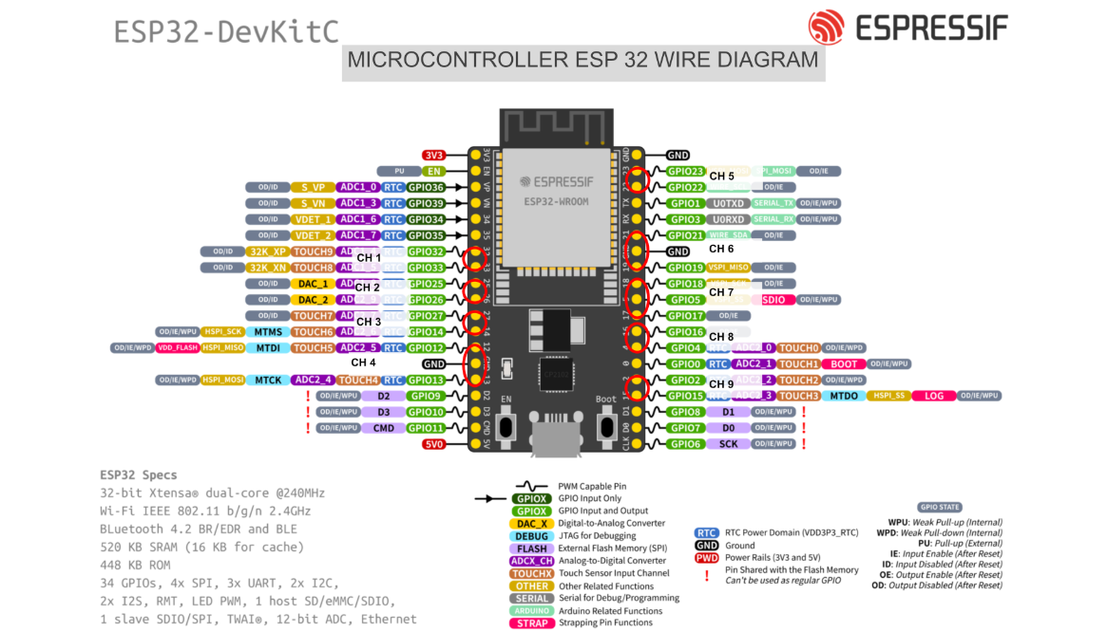
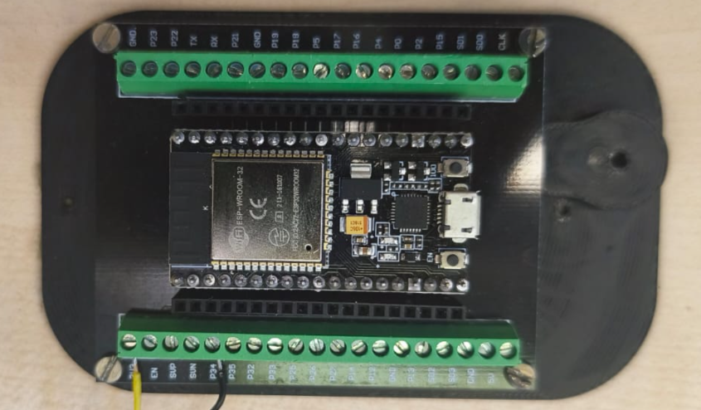
5. Microcontroller Interfacing (ESP32)
The ESP32 is a high-performance, low-cost microcontroller designed for complex data processing and multi-sensor management. In this project, it acts as the "brain" of the DAQ system, using its high clock speed to capture and stream synchronized data from nine measurement channels simultaneously

Slide 10
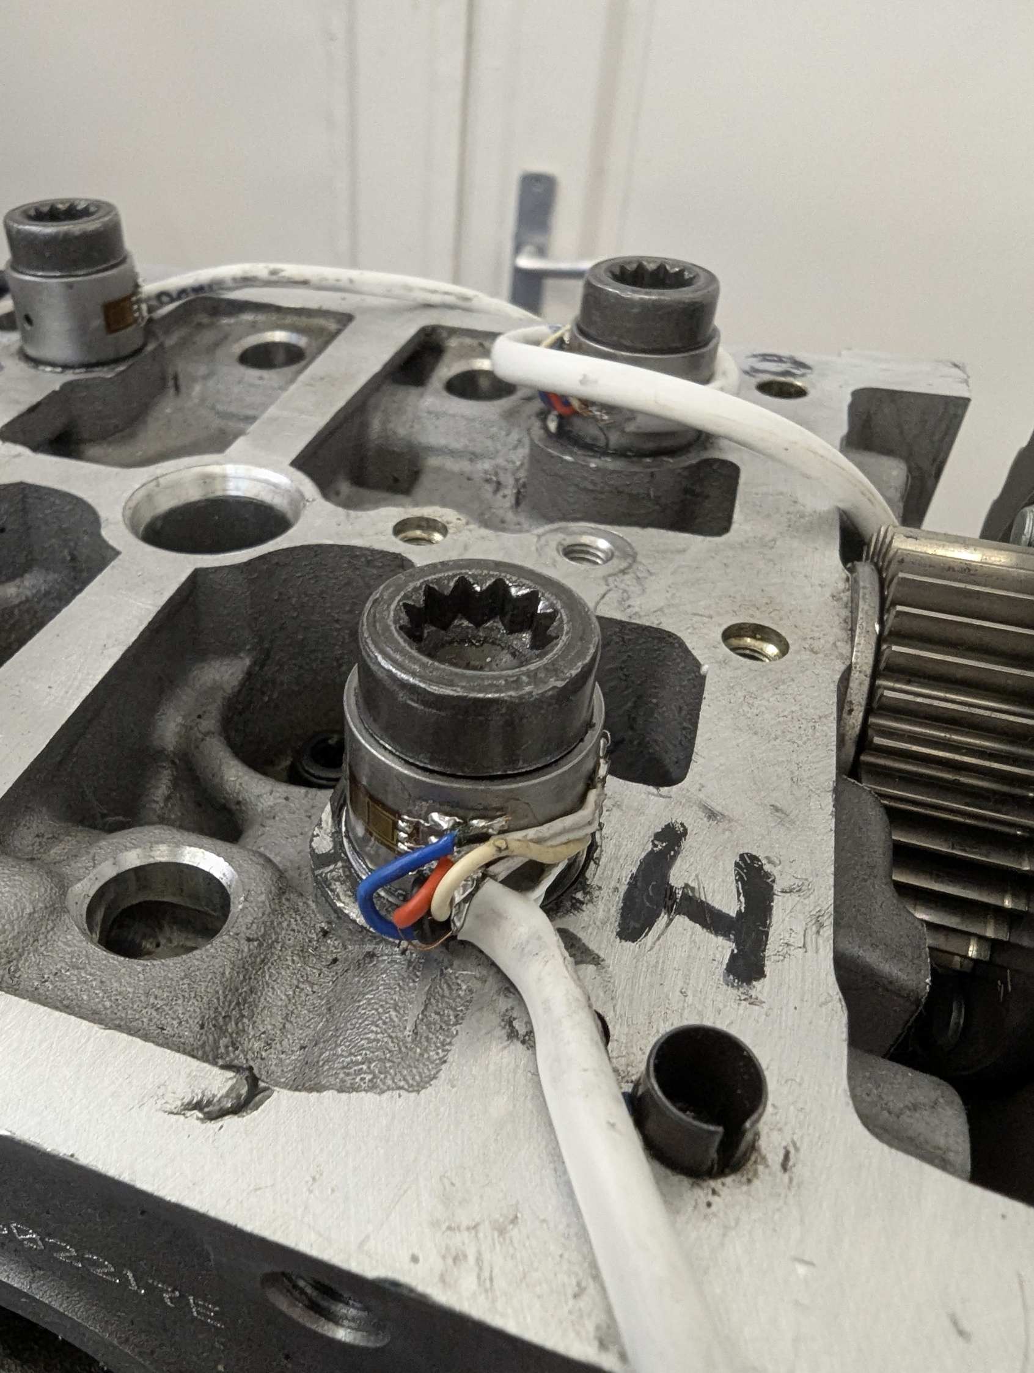
Final assembly
The final assembly integrates the mechanical, electrical, and software components into a unified 9-channel measurement station.
Physical & Electrical Integration
Sensor Array: Eight custom transducers are fitted to the cylinder head bolts, while a ninth channel is dedicated to an instrumented torque wrench.
Signal Chain: Each transducer's Full Wheatstone Bridge connects to an HX711 ADC module, which amplifies and digitizes the raw force data.
Control Hub: All nine HX711 modules are wired to an ESP32 microcontroller.

Slide 11
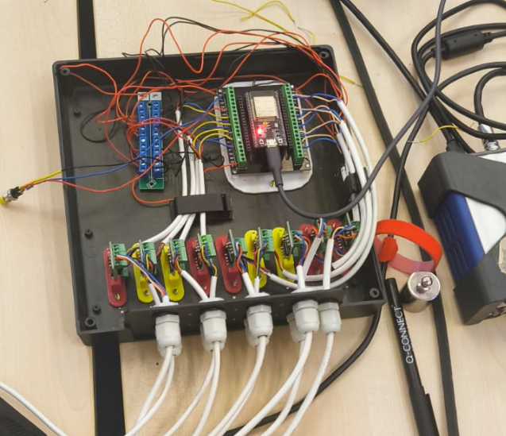
Channels 1-8 (Bolts): Connected directly to the cylinder head bolts to capture the clamping force distribution across the engine block.
Channel 9 (Wrench): Connected to the instrumented torque wrench. This channel allows us to correlate the applied torque (input) with the resulting clamping force (output) on the bolts.

Slide 12
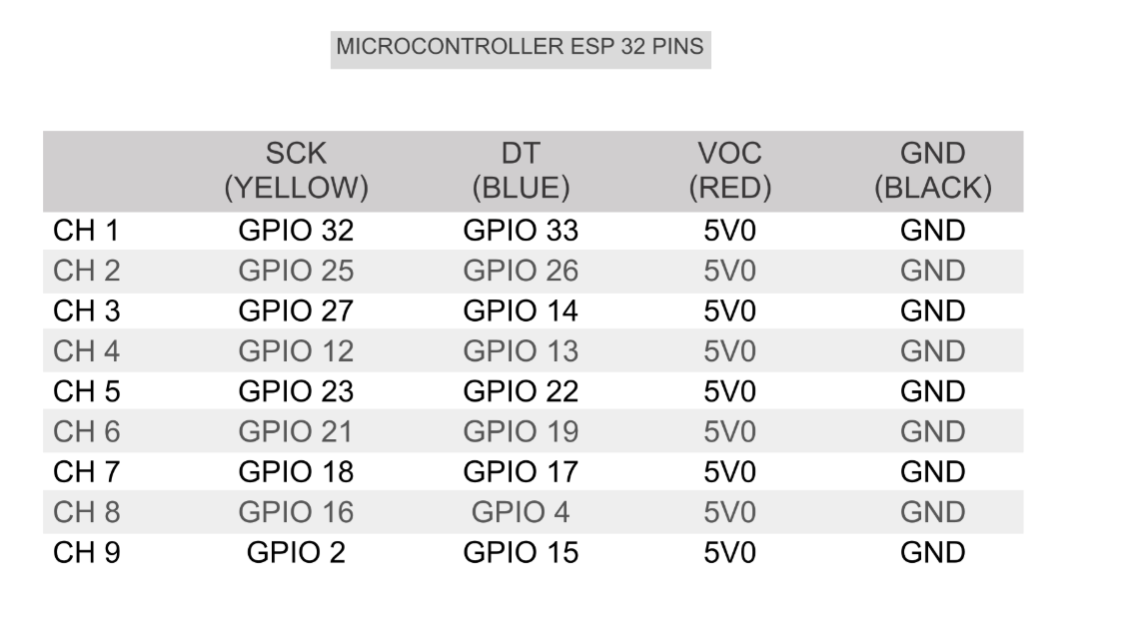
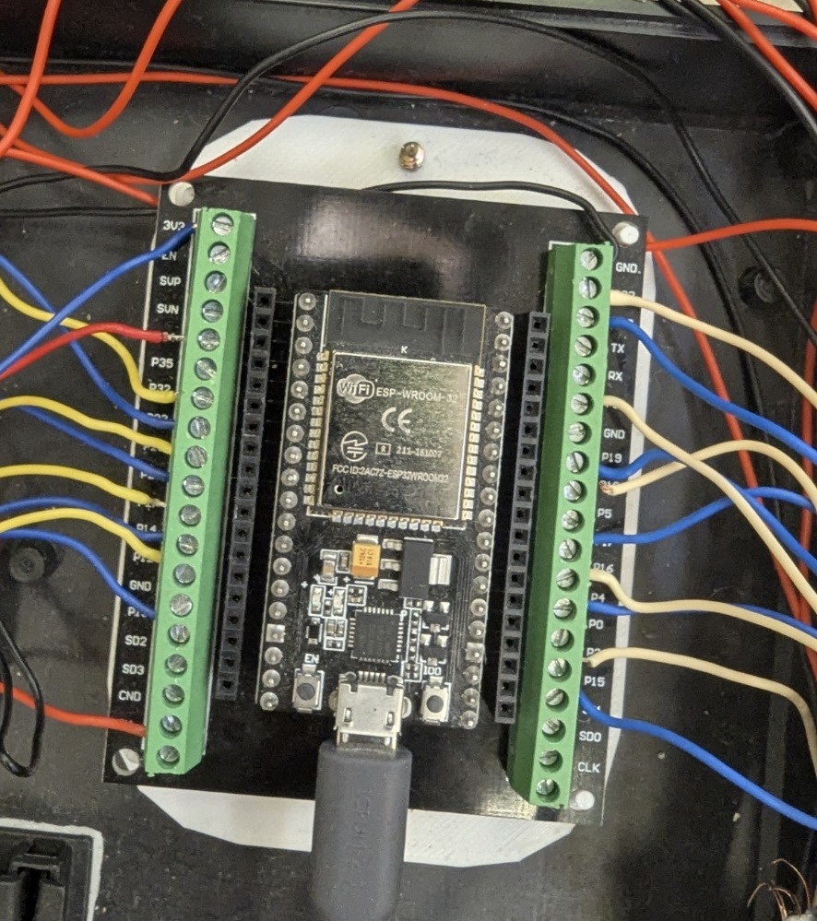
DAQ software architecture (NodeMCU ESP32)
Direct Parallel Interface: 18 GPIO pins used → 9 clock + 9 data → Maximum signal speed
Sampling rate: 10Hz (100ms interval) using non blocking timers.
Calibration: Hard coded sensitivity slopes for all the 9 channels to ensure efficient processing.
Output: Live CSV stream to PC via Serial (9600 baud) for excel integration.

Slide 13
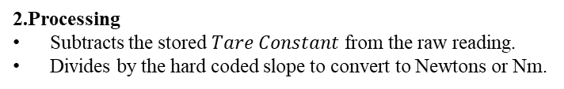
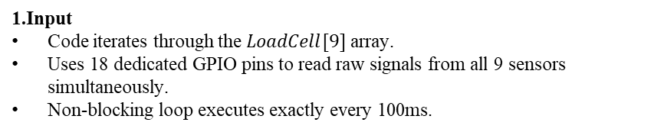
Operation
1.Input
Code iterates through the $LoadCell[9]$ array.
Uses 18 dedicated GPIO pins to read raw signals from all 9 sensors simultaneously.
Non-blocking loop executes exactly every 100ms.
2.Processing
Subtracts the stored $Tare Constant$ from the raw reading.
Divides by the hard coded slope to convert to Newtons or Nm.
3.Output
Makes a single CSV string that includes all the 9 values + timestamp.
Streams via USB serial directly to Excel data streamer for live visualization,

Slide 14
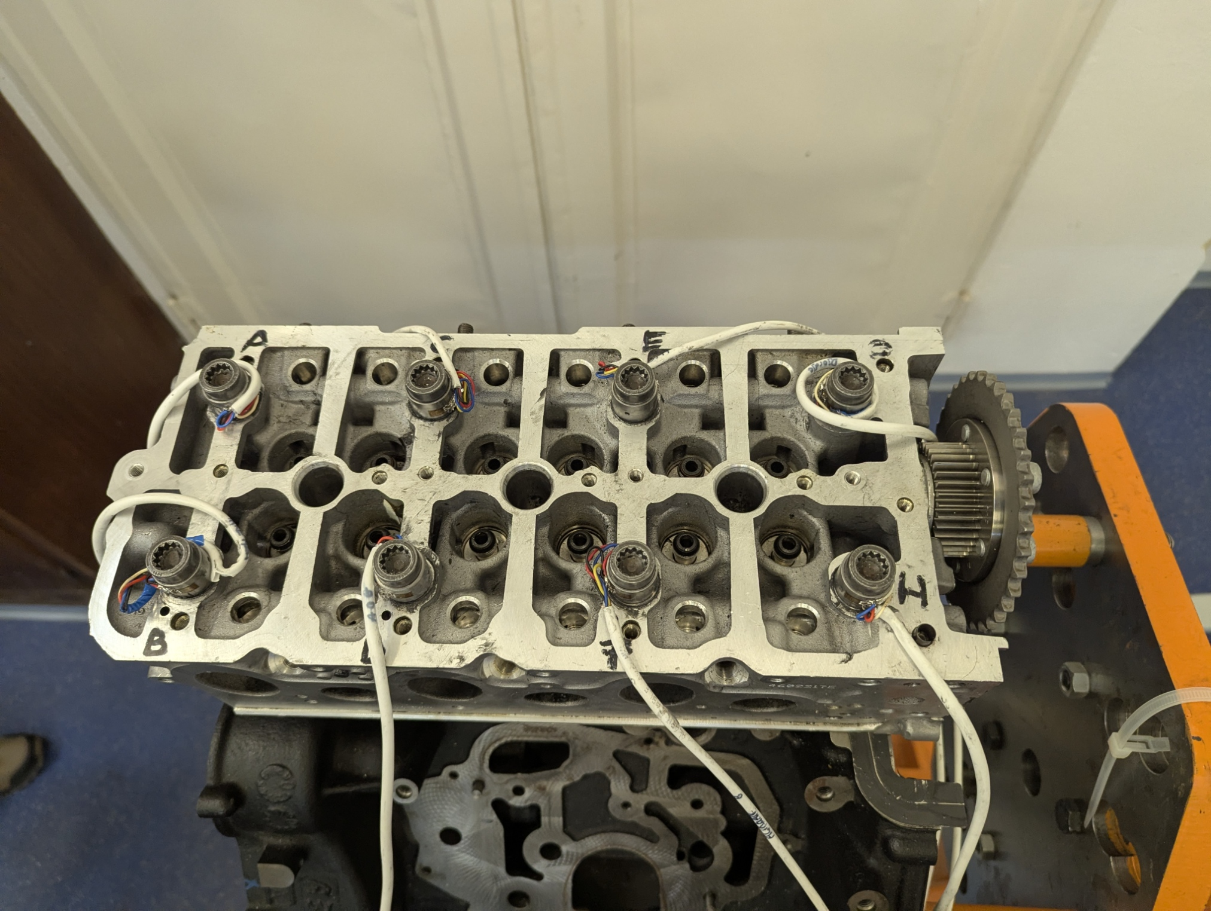
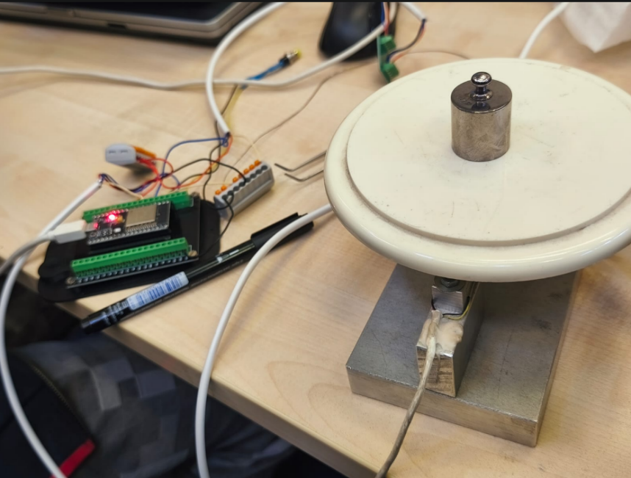
Calibration
Procedure:
Each bolt was individually stressed with known reference loads.
Linear regression was used to calculate the specific sensitivity (Slope) for each sensor.
Implementation:
To save processor cycles during the measurement loop, these values were hard coded into the firmware arrays.
Verification:
System was tared with a 100g weight.
Removing the weight resulted in -100 reading confirming perfect linearity and slope accuracy.

Slide 15
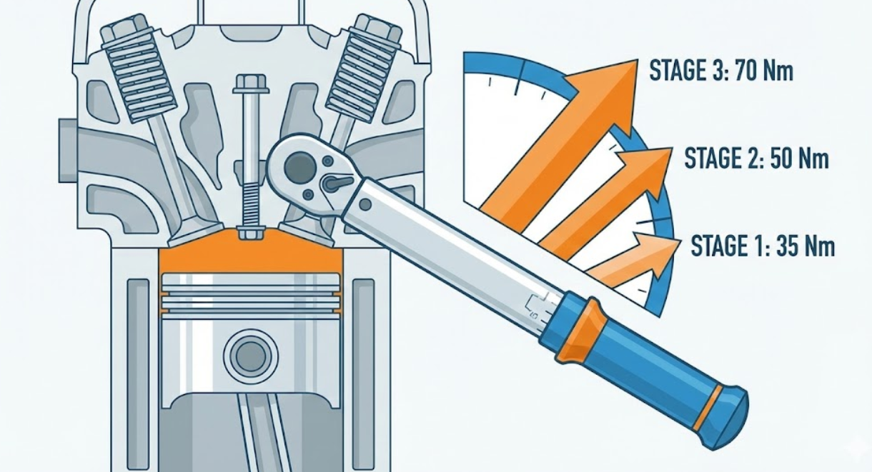
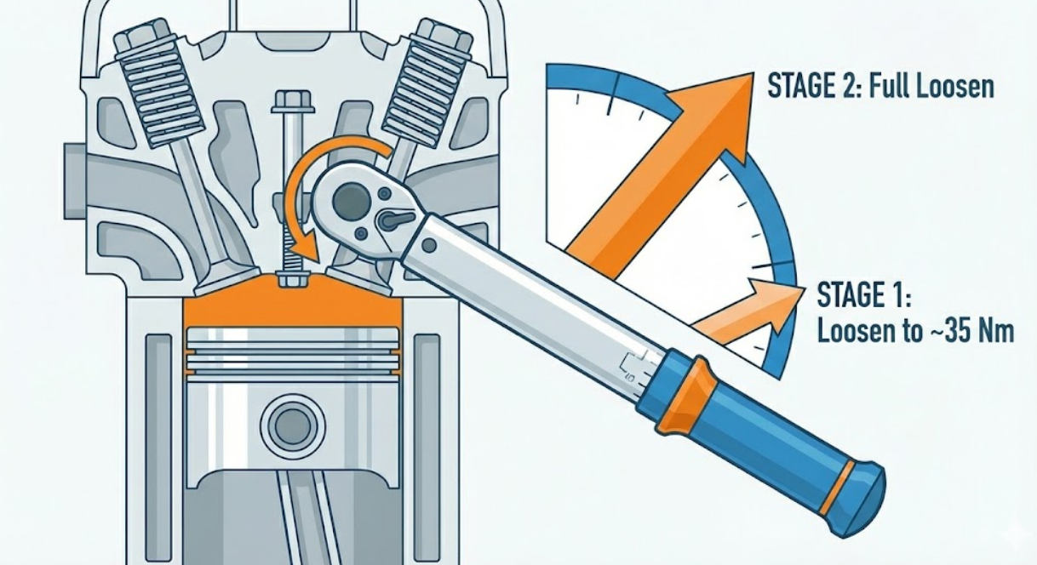
Experimental Measurement Protocol
Bolt tightening
Bolt loosening

Slide 16
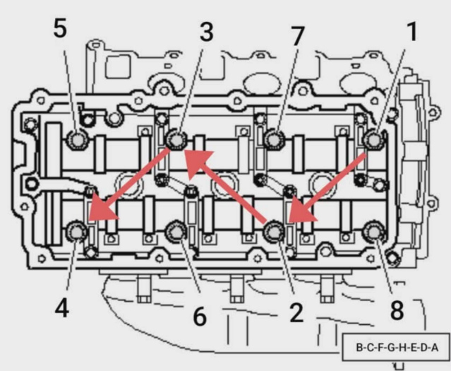
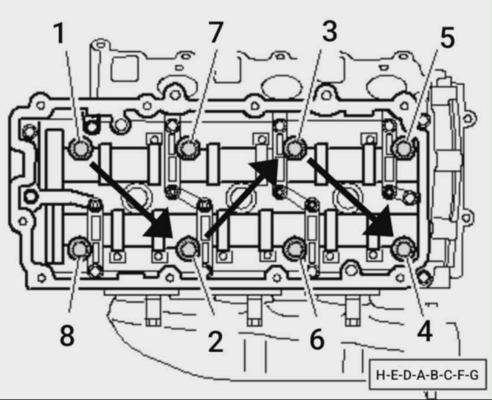
Tested Sequences
Sequence A
Sequence B

Slide 17
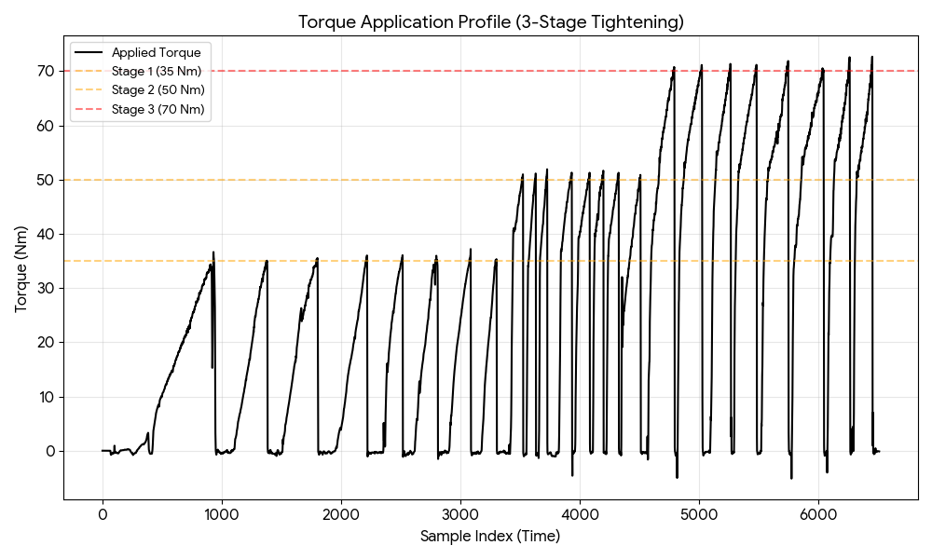
Application of Torque – Graphical Representation
11
1 min
2 min
3 min
4 min
5 min
6 min

Slide 18
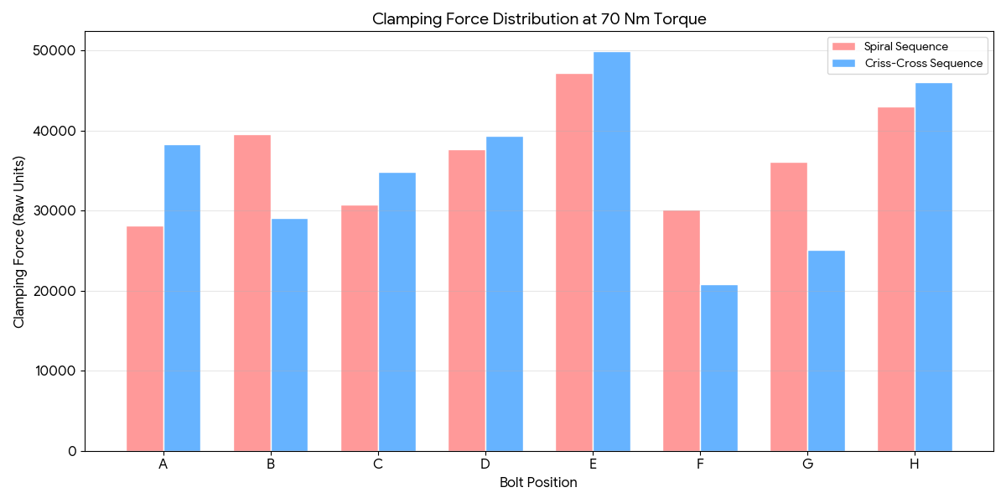
Clamping force Distribution – Graphical Analysis
Sequence B
Sequence A

Slide 19
Analysis Summary
 | Sequence A (Standard) | Sequence B (Reversed)
Order | B-C-F-G-H-E-D-A | H-E-D-A-B-C-F-G
Max Force | ~52,000 units (Bolt E) | ~48,700 units (Bolt E)
Min Force | ~24,200 units (Bolt F) | ~26,300 units (Bolt F)
Variation | High (~27,800) | Lower (~22,350)
Uniformity | Poor Distribution | Marginal Improvement

Slide 20
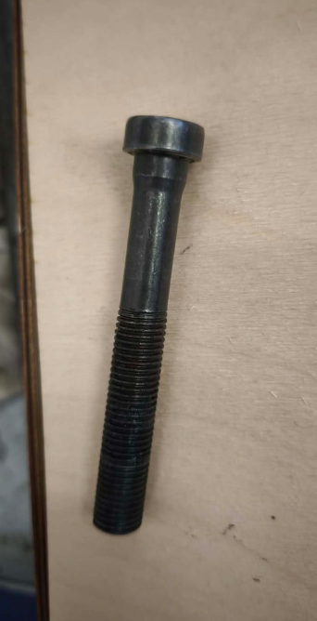
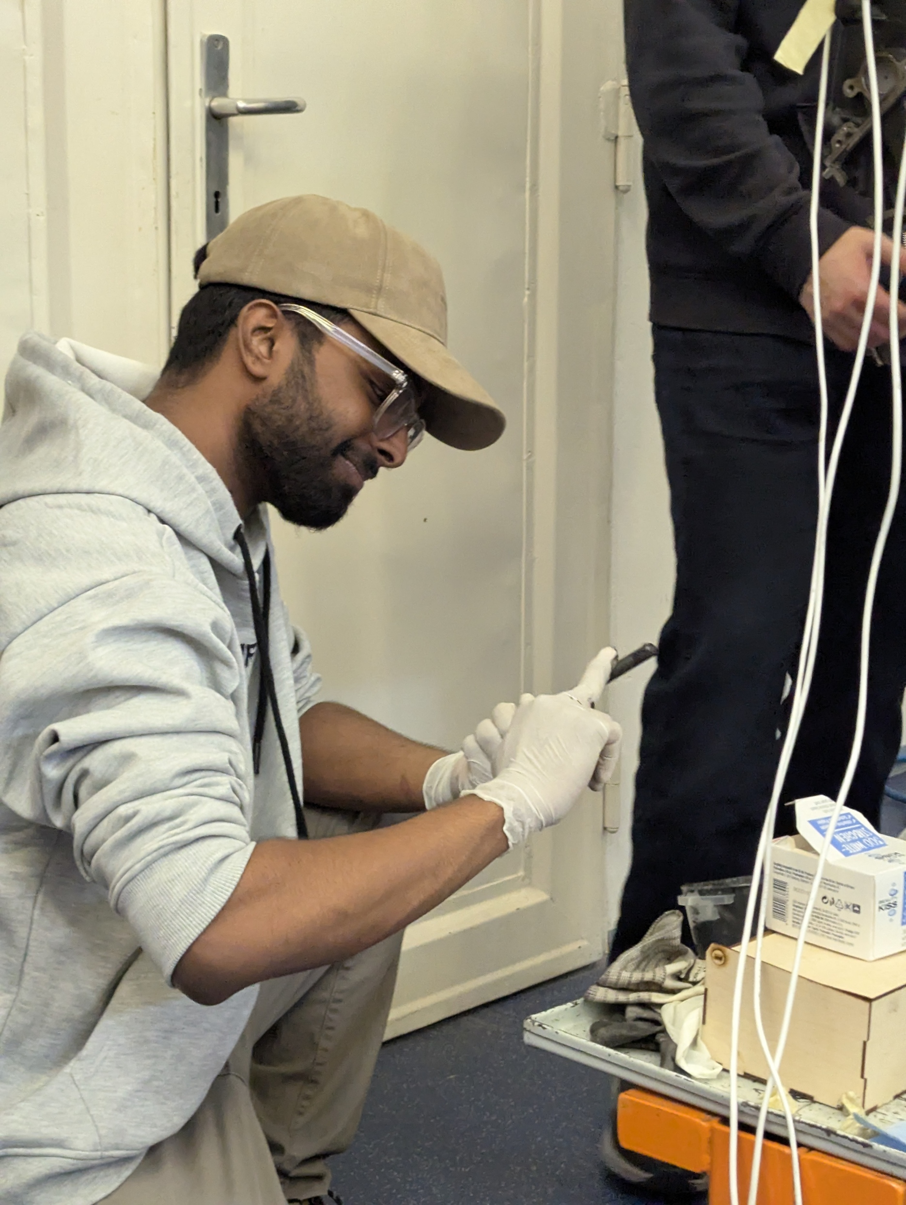
Why differences?
The observation:
Both sequences used “crisscross” pattern, but sequence B resulted less variation and higher minimum clamping force.
Probable cause:
Uneven deformation of the bolts because of repeated tightening and loosening.
Uneven distribution of lubricant.
Wear and deformation of the threads in the block.(torque to yield bolts)

Slide 21
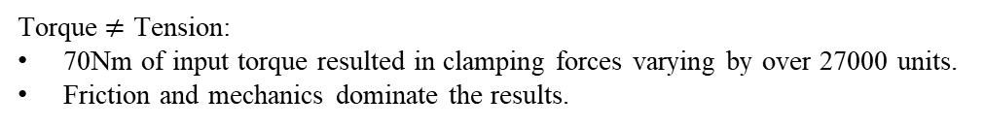
Conclusion
Torque$≠$ Tension:
70Nm of input torque resulted in clamping forces varying by over 27000 units.
Friction and mechanics dominate the results.
External factors:
Usage of lubricant resulted in improved clamping forces.
Even with perfect tightening sequence, factors like uniform lubrication plays a key role.
System viability:
The custom ESP32 DAQ successfully captured transient phenomena at 10Hz,
It shows that even the low-cost hardware can deliver professional engineering insights.

Slide 22
Thank you!

